Slide 1
Anterior Paddle Distractor: Project Overview
Victor Nunez, Greg Nelson
Tek Park, 10 Feb 2016

Slide 2
User Needs
Must be made of a standard medical grade materials.
Must be cleanable and sterilizable.
Must apply a distraction force that is parallel to the axis of the spine at the site of surgery.
Must withstand a compression force of at least 1000N distributed across the instrument paddles.
Must have a ratchet system to maintain the applied distraction force without constant input from the surgeon.
Must have interchangeable / adjustable paddles that align with standard anterior device sizes.
Must have a “quick connect” system to attach paddles to the instrument.
Must have an impaction handle that can be easily (i.e. using one hand) removed.
Must have a narrow profile to maximize visualization of the surgical site during use.
Must have a spring that closes / resets the paddles upon release of the isntrument handles.

Slide 3
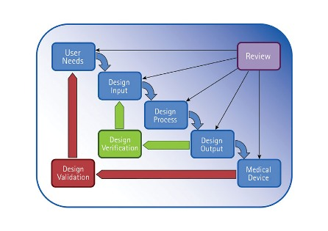
Medical Device Development Process

Slide 4
Design Constraints / Considerations
Material Considerations
Biocompatibility
Corrosion Resistance
Mechanical Integrity
Forces in the Spine
Fracture loads of the vertebral bodies
Loads needed to distract the spine
Mechanical force exerted by human hand
Ease of Use
Ergonomics
Surgeon preference
Visualization (SO vs. Mini Access vs. MIS)
Manufacturing Considerations
Machine Limitations
Dimensioning & Tolerancing
Materials
Cost Considerations
Manufacturing Methods
Complexity
Materials
System Interaction
Implant sizes
Surgical Technique
Set Definition

Slide 5
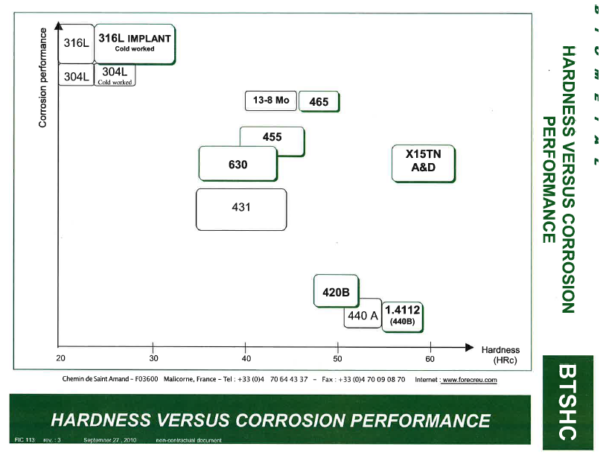
Material Considerations

Slide 6
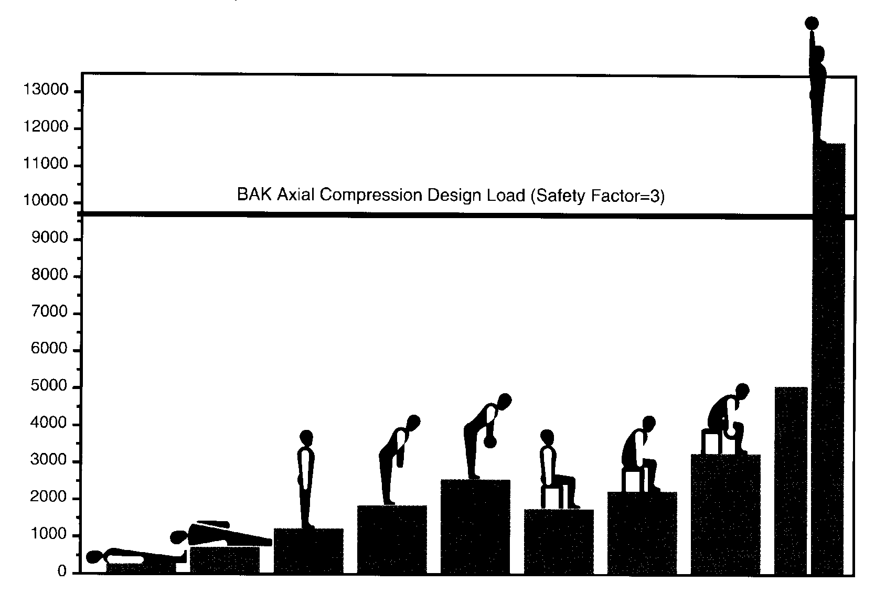
Forces in the Spine

Slide 7
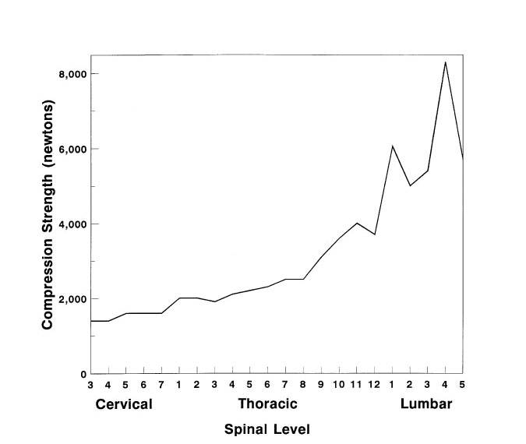
Forces in the Spine, Cont’d

Slide 8
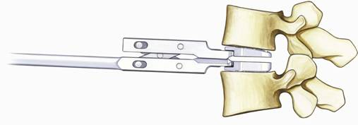

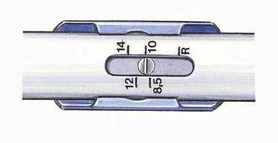
Ease of Use
New instrument with several functions:
Parallel distraction

Slide 9
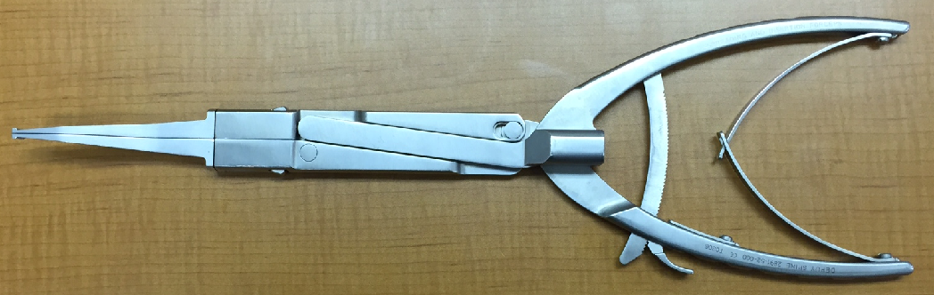
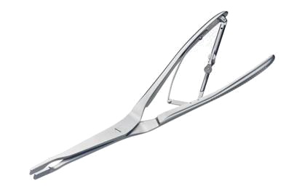
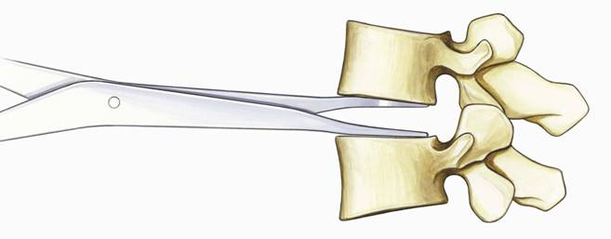
Ease of Use, Cont’d
Distraction forceps with angled handle

Slide 10
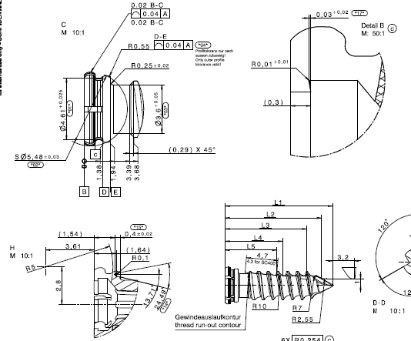
Manufacturing Considerations

Slide 11
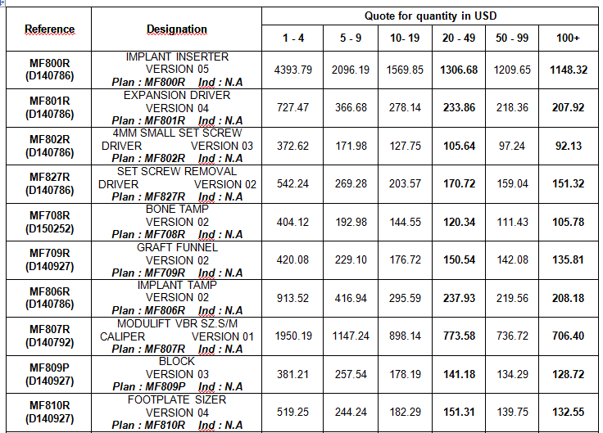
Cost Considerations

Slide 12
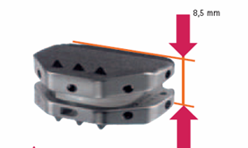
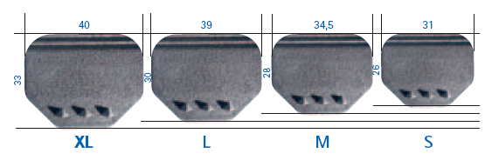
Set Interaction
Wide Range of Sizes
Notes:
Match the best size activL implant according to the X-Ray Template.
activL offers the smallest height currently on the market Height range: 8.5 mm, 10 mm,12 mm, 14 mm
Clinical Study: In 9 out of 11 cases, the inlay for 8.5 mm height was chosen.
Warning:
■ In order to make sure that a proper fixation and alignment of the activL® artificial disc can be achieved, patients with endplate
dimensions smaller than 31 mm in medial-lateral and/or 26 mm in anterior-posterior directions are not appropriate candidates for activL surgery due to limitations in available
sizes.

